Slide 1
LECTURE 6

Slide 2


Type - C
R_{S}
=
R₁ + R₂ + R₃
numerical
1
1
1
1
=
+
+
R_{P}
R₁
R₂
R₃

Slide 3

Q.1.
A battery of 9V is connected in series with resistance of 0.2Ω, 0.3Ω, 0.4Ω, 0.5Ω and 12Ω respectively. How much current would flow through the 12Ω resistor ?
Given :
Total resistance, R
= 0.2 + 0.3 + 0.4 + 0.5 + 12 = 13.4Ω
V
= 9V
To find :
Current (I)
= ?
Formula :
V =
IR
V
Solution :
I =
R
9
=
Current through 12 Ω resistor = 0.67A.
13.4
=
0.67 A

Slide 4
Q2.
Judge the equivalent resistance when the following are connected in parallel :
(a) 1Ω and 10⁶Ω
(b) 1Ω and 10³Ω and 10⁶Ω
(a)
1Ω and 10⁶Ω are connected in parallel.
Ans. :
∴
1
1
1
10⁶ + 1
=
+
=
∴ Equivalent Resistance ≈ 1Ω (but less than 1Ω)
R
1
10⁶
10⁶
10⁶
10⁶
∴
R =
≈
10⁶ + 1
10⁶
≈
1Ω
(b)
1Ω, 10³Ω and 10⁶Ω are in parallel.
1
1
1
1
1000000
∴
=
+
+
∴
R =
R
1
10³
10⁶
1001001
1
10⁶ + 10³ + 1
∴
R =
0.999 Ω
∴
=
R
10⁶
∴ Equivalent Resistance = 0.999Ω

Slide 5
Q.3.
An electric lamp of 100Ω, a toaster of resistance 50Ω, and a water filter of resistance 500Ω are connected in parallel to a 220V source. What is the resistance of an electric iron connected to the same source that takes as much current as all three appliances, and what is the current through it?
Given :
Resistance of lamps = R₁ = 100Ω
Resistance of toaster = R₂ = 50 Ω
Resistance of filter = R₃ = 500 Ω
V = 220V
500
∴ R =
16
According to Ohm’s law, V = IR
V
220
220 x 16
∴
I =
=
=
=
7.04A
To find :
Resistance of iron, Current through iron
R
500
500
1
1
1
1
16
Formula :
=
+
+
,V = IR
7.04 A current is drawn by all three appliances.
R
R₁
R₂
R₃
Solution :
Let R be the equivalent resistance,
∴ Current drawn by an electric iron connected to the same source of P.D. 220V = 7.04A
1
1
1
1
=
+
+
R
R₁
R₂
R₃
∴ It’s Resistance,
1
1
1
R =
V
220
31.25Ω
=
+
+
=
=
100
50
500
I
7.04
5 + 10 + 1
16
∴ Current flowing through iron = 7.04A Resistance of iron = 31.25 Ω
=
=
500
500

Slide 6
Q.4.
How can three resistors of resistance 2Ω, 3Ω and 6Ω be connected to give a total resistance of (a) 4Ω, (b) 1Ω?
Ans. :
R₁ = 2Ω, R₂ = 3Ω, R₃ = 6Ω
(a)
To get R_{e} = 4Ω, the circuit is as shown,
R₂ and R₃ are in parallel
R₃ = 6Ω
R₁ = 2Ω
1
1
1
1
1
∴
=
+
=
+
R_{p}
R₂
R₃
3
6
1
2+1
3
1
R₂ = 3Ω
=
=
=
R_{p}
6
6
2
∴
R_{p} =
2Ω
+
-
R_{p} and R₁ are in series
∴
R_{e} =
R_{p} + R₁
=
2 + 2
R_{e} =
4Ω

Slide 7
Q.4.
How can three resistors of resistance 2Ω, 3Ω and 6Ω be connected to give a total resistance of (a) 4Ω, (b) 1Ω?
Ans. :
(b)
To get R_{e} = 1Ω, the circuit is as shown,
1
1
1
1
=
+
+
R₁ = 2Ω
R_{e}
R₁
R₂
R₃
1
1
1
=
+
+
R₂ = 3Ω
2
3
6
2 + 3 + 1
=
R₃ = 6Ω
6
6
=
= 1Ω
6
+
-
∴
R_{e} =
1Ω

Slide 8

5
An electric lamp, whose resistance is 20 Ω , and a conductor of 4 Ω resistance are connected to a 6 V battery. Calculate
(a) the total resistance of the circuit,
(b) the current through the circuit, and
(c) the potential difference across the electric conductor and lamp
Given :
Resistance of electric lamp, (R₁)
= 20 Ω
R₂
R₁
Resistance of conductor, (R₂)
= 4 Ω
4 Ω
20 Ω
Potential difference (V)
= 6 V
I
I
To find :
(a)
total resistance (R)
= ?
V
+
–
K
= ?
A
(b)
Current (I)
6 V
(c)
potential difference across lamp (V₁)
= ?
potential difference across conductor (V₂)
= ?
Formulae :
R_{S} =
R₁ + R₂
V =
IR

Slide 9


5
An electric lamp, whose resistance is 20 Ω , and a conductor of 4 Ω resistance are connected to a 6 V battery. Calculate
(a) the total resistance of the circuit,
(b) the current through the circuit, and
(c) the potential difference across the electric conductor and lamp
Solution :
(c)
(i)
P.D. across the electric lamp
R₂
R₁
(a)
Total resistance (R_{S})
V₁ =
I × R₁
4 Ω
R_{S} =
R₁ + R₂
20 Ω
∴
V₁ =
0.25
× 20
I
∴
R_{S} =
20
+ 4
I
∴
V₁ =
5 V
∴
R_{S} =
24 Ω
V
K
(ii)
P.D. across the electric
conductor
+
–
A
(b)
Total current (I)
6 V
V
V₂ =
I × R₂
∴
$\text{I}$ =
R_{S}
∴
V₂ =
0.25
× 4
6
∴
$\text{I}$ =
∴
V₂ =
1 V
24
Ans :
Total resistance is 24 Ω, Total current is 0.25 A, P.D across lamp is 5 V, P.D across conductor is 1 V.
∴
I =
0.25 A

Slide 10
In the circuit diagram given suppose the resistors R₁, R₂ and R₃ have the values 5 Ω, 10 Ω and 30 Ω, respectively, which have been connected to a battery of 12 V. Calculate (a) the current through each resistor, (b) the total current, (c) the total resistance.
6
+
–
R₁ = 5 Ω
I₁
A
I₂
+
–
R₂ = 10 Ω
A
P
Q
+
I₃
+
–
R₃ = 30 Ω
A
I
A
–
+
–
K
V = 12 V

Slide 11
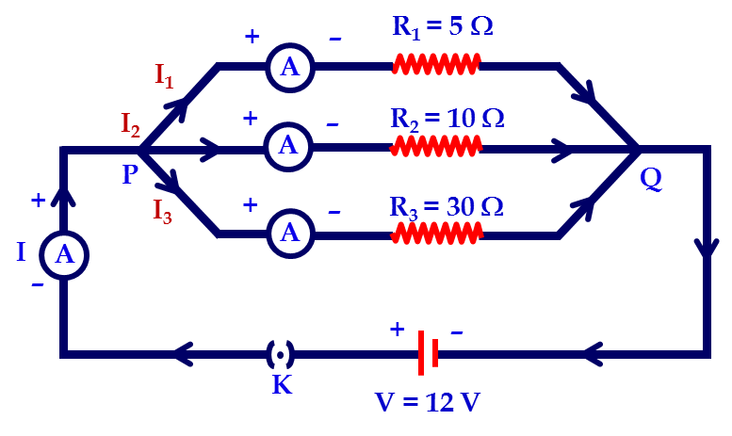
In the circuit diagram given suppose the resistors R₁, R₂ and R₃ have the values 5 Ω, 10 Ω and 30 Ω, respectively, which have been connected to a battery of 12 V. Calculate (a) the current through each resistor, (b) the total current, (c) the total resistance.
6
Given :
R₁
= 5 Ω
Solution :
R₂
= 10 Ω
1
1
1
1
R₃
= 30 Ω
1.
=
+
+
R_{p}
R₁
R₂
R₃
V
= 12 V
1
1
1
1
To find :
Effective resistance (R_{P}) = ?
Total current (I) = ?
Current in each resistor
i.e. I₁, I₂ and I_{3.}
∴
=
+
+
R_{p}
5
10
30
(6)
(3)
(1)
1
6 + 3 + 1
1
1
1
1
∴
=
Formulae :
1.
=
+
+
R_{p}
30
30
R_{p}
R₁
R₂
R₃
∴
R_{p}
=
1
10
10
2. V = IR
∴
=
R_{p}
30
∴
R_{p}
=
3 Ω

Slide 12






In the circuit diagram given suppose the resistors R₁, R₂ and R₃ have the values 5 Ω, 10 Ω and 30 Ω, respectively, which have been connected to a battery of 12 V. Calculate (a) the current through each resistor, (b) the total current, (c) the total resistance.
6
2. I₁ = $\frac{\text{V}}{\text{R}\text{1}}$
3. I₂ = $\frac{\text{V}}{\text{R}\text{2}}$
Ans :
∴ I₁ = $\frac{\text{12}}{\text{5}}$
∴ I₂ = $\frac{\text{12}}{\text{10}}$
Effective resistance in parallel is 3 Ω.
Total current is 4 A.
Current is each resistor is 2.4 A, 1.2 A, 0.4 A.
∴ I₁ = 2.4 A
∴ I₂ = 1.2 A
4. I₃ = $\frac{\text{V}}{\text{R}\text{3}}$
5. I = I₁ + I₂ + I₃
∴ I₃ = $\frac{\text{12}}{\text{30}}$
∴ I = 2.4 + 1.2 + 0.4
∴ I = 4 A
∴ I₃ = 0.4 A

Slide 13
7
If in circuit diagram, R₁ = 10Ω, R₂ = 40Ω, R₃ = 30Ω, R₄ = 20 Ω, R₅ = 60Ω, a 12 V battery is connected to the arrangement.
Calculate (a) the total resistance (b) the total current flowing
R₁ = 10Ω
R₂ = 40Ω
+
I
12 V
–
A
R₃ = 30Ω
K
R₄ = 20Ω
R₅ = 60Ω

Slide 14
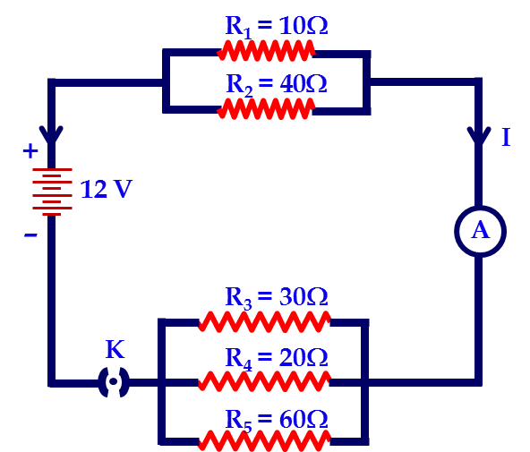
7
If in circuit diagram, R₁ = 10Ω, R₂ = 40Ω, R₃ = 30Ω, R₄ = 20 Ω, R₅ = 60Ω, a 12 V battery is connected to the arrangement.
Calculate (a) the total resistance (b) the total current flowing
Given :
R₁
= 10 Ω
Solution :
R₂
= 40 Ω
Let R_{P1} be the equivalent resistance of R₁ and R₂
R₃
= 30 Ω
R₄
= 20 Ω
1
1
1
R₅
= 60 Ω
=
+
R_{P}
R₁
R₂
V
= 12 V
1
1
1
Total resistance (R)
=
+
To find :
= ?
R_{P1}
10
40
Total current (I)
= ?
1
1
4
+ 1
5
1
1
1
∴
=
=
Formulae :
=
+
R_{P1}
40
40
R_{P}
R₁
R₂
8
∴
R_{P1} = 8
V
Ω
I =
R

Slide 15
7
If in circuit diagram, R₁ = 10Ω, R₂ = 40Ω, R₃ = 30Ω, R₄ = 20 Ω, R₅ = 60Ω, a 12 V battery is connected to the arrangement.
Calculate (a) the total resistance (b) the total current flowing
Let R_{P2} be the equivalent resistance of R_{3 ,}R₄ and R₅ then,
Total resistance (R)
R =
R_{P1}
+
R_{P2}
1
1
1
1
∴
R =
8
+
10
=
+
+
R_{P2}
R₃
R₄
R₅
R = 18 Ω
1
1
1
1
∴
=
+
+
R_{P2}
30
20
60
Total Current (I)
1
V
1
2
+ 3
+ 1
6
I
=
∴
=
=
R
R_{P2}
60
60
2
10
12
∴
R_{P2} = 10 Ω
∴
I
=
18
3
2
Now R_{P1} and R_{P2} are connected in series.
∴
I
=
Ans :
The total resistance of the circuit is 18Ω and the total current is 0.67 A
3
I = 0.67
A

Slide 16
8
Show how you would connect three resistors, each of resistance 6 Ω, so that the combination has a resistance of
(i) 9 Ω (ii) 4 Ω
Given :
R₁
= 6 Ω
1
1
1
=
+
R₂
= 6 Ω
R_{P}
R₁
R₂
R₃
= 6 Ω
1
1
=
+
6
6
To find :
How to connect to get:
1
2
6
(i) 9 Ω (ii) 4 Ω
=
∴ R_{P}
=
R_{P}
6
2
1
1
1
1
Formulae :
=
+
+
∴ R_{P} = 3 Ω
R_{P}
R₁
R₂
R₃
Now R_{P} and R₃ are connected in series.
R_{S} = R₁ + R₂+ R₃
∴ R = R_{P} + R₃
Solution :
(i) To get 9 Ω:
= 3 + 6
= 9 Ω
(i) R₁ and R₂ are connected in parallel
To get combination of 9 Ω R₁ and R₂ are connected in parallel and R₃ is connected in series with them

Slide 17
8
Show how you would connect three resistors, each of resistance 6 Ω, so that the combination has a resistance of
(i) 9 Ω (ii) 4 Ω
Given :
R₁
= 6 Ω
R_{S} = 6 + 6 = 12 Ω
R₂
= 6 Ω
Now R_{s} and R₃ are connected in parallel.
R₃
= 6 Ω
1
1
1
To find :
How to connect to get:
=
+
R_{P}
R_{S}
R₃
(i) 9 Ω (ii) 4 Ω
1
1
1
1
1
1
=
+
Formulae :
=
+
+
12
6
R_{P}
R₁
R₂
R₃
1 + 2
=
R_{S} = R₁ + R₂+ R₃
12
1
3
=
∴ R_{P} = 4 Ω
Solution :
(ii) To get 4 Ω :
R_{P}
12
(ii) R₁ and R₂ are connected in series.
To get combination of 4 Ω R₁ and R₂ are connected in series and R₃ is connected in parallel with them.
R_{S} = R₁ + R₂

Slide 18
Q.9.
What is (a) the highest, (b) the lowest total resistance that can be secured by combinations of four coils of resistance 4Ω, 8Ω, 12Ω, 24Ω?
Given :
R₁ = 4Ω
R₂ = 8Ω
R₃ = 12Ω
R₄ = 24Ω
(b) To get lowest equivalent resistance, these resistance should be connected in parallel.
To find :
(a) Highest equivalent resistance
∴
1
1
1
1
1
=
+
+
+
R
4
8
12
24
(b) Lowest equivalent resistance
6 + 3 + 2 +1
Solution :
(a) To get highest equivalent resistance, these resistances should be connected in series.
=
24
12
1
=
=
24
2
R =
R₁ + R₂ + R₃ + R₄
∴ R =
2 Ω
=
4 + 8 + 12 + 24
= 48 Ω

Slide 19
10
How many 176 Ω resistors (in parallel) are required to carry 5 A on a 220 V line?
Given :
Voltage (V)
= 220 V
R
R_{eq}
=
n
Current (I)
= 5 A
Resistance of single resistor (R)
= 176 Ω
R
n
=
Formula for Equivalent resistance of n resistors connected in parallel
R_{eq}
To find :
No. of resistors (n) = ?
R
176
Formulae :
V = IR ,
R_{eq}
=
n
=
n
44
Solution :
V = IR
n
=
4
V
… … (i)
R_{eq} =
I
220
Ans :
4 resistors of 176 Ω are required to draw the given amount of current.
=
5
= 44 Ω

Slide 20
Thank You

